Slide 1
VIRAL INFECTIONS

Slide 2
Systemic viral infections with exanthem:
Exanthem is the term classically used to describe a widespread rash associated with fever in childhood.
Maternal antibody gives protection for the first 6–12 months of life and infection occurs thereafter.

Slide 3
Comprehensive immunisation programmes have eradicated many of these conditions but lapses in vaccination result in continued infections, which now often present in older children and adults.

Slide 4
1- Measles:
Before immunisation campaigns, measles occurred in almost 100% of children world-wide.
The WHO has set the objective of eradicating measles globally by 2010, using the live attenuated vaccine.
However, vaccination of only 70–80% of the population, as is currently the case in the UK, for example, is insufficient to prevent outbreaks in older children and adults, who are more susceptible to complications.
Natural illness produces lifelong immunity.

Slide 5
Clinical features:
Infection is by respiratory droplets with an incubation period of 6–19 days.
A prodromal illness, 1–3 days before the rash, occurs with upper respiratory symptoms, conjunctivitis and the presence of Koplik’s spots on the internal buccal mucosa.

Slide 6
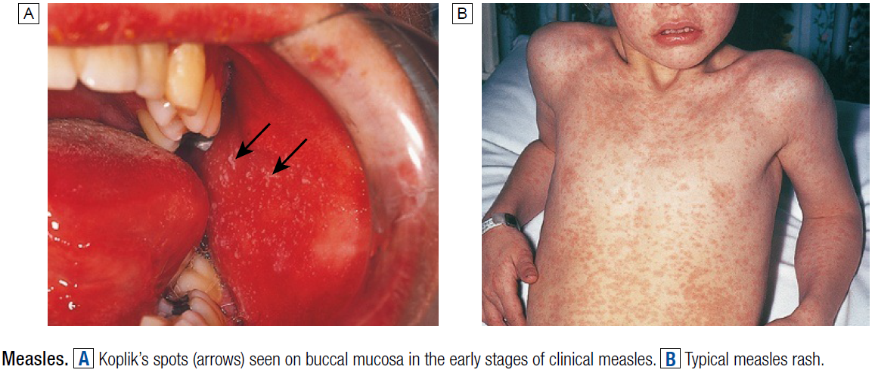

Slide 7
These small white spots surrounded by erythema are pathognomonic of measles.
As natural antibody develops, the maculopapular rash appears, spreading from the face to the extremities.
Generalised lymphadenopathy and diarrhoea are common, with otitis media and bacterial pneumonia recognised complications.

Slide 8
Clinical encephalitis occurs in approximately 0.1% of children.
A rare late complication is subacute sclerosing panencephalitis (SSPE), which occurs up to 7 years after infection.
Diagnosis is clinical (although this is unreliable in areas where measles is no longer common) and by detection of antibody (serum IgM, seroconversion or salivary IgM).

Slide 9
Disease is more severe and prolonged in adults and complications include pneumonitis, hepatitis and encephalitis.
Measles is a serious disease in the malnourished, vitamin-deficient or immunocompromised, in whom the typical rash may be missing and persistent infection with a giant cell pneumonitis or encephalitis may occur.

Slide 10
In tuberculosis infection, measles suppresses cell-mediated immunity and may exacerbate disease; for this reason, measles vaccination should be deferred until after commencing antituberculous treatment.
Measles does not cause congenital malformation but may be more severe in pregnant women.

Slide 11
Mortality clusters at the extremes of age, averaging 1:1000 in developed countries and up to 1:4 in developing countries.
Death usually results from bacterial superinfection such as pneumonia, diarrhoeal disease or noma/cancrum oris.

Slide 12
Management and prevention:
Normal immunoglobulin attenuates the disease in the immunocompromised (regardless of vaccination status) and in non-immune pregnant women, but must be given within 6 days of exposure.
Vaccination can be used in outbreaks and vitamin A may improve the outcome in uncomplicated disease.
Antibiotic therapy is reserved for bacterial complications

Slide 13
All children aged 12–15 months (when maternal antibody will no longer be present) should receive measles vaccination (as combined measles, mumps and rubella (MMR), a live attenuated vaccine), and a further MMR dose at the age of 4 years.

Slide 14
2- Rubella (German measles):
Rubella is an endemic exanthem in countries without universal vaccination.
In non-immunised communities 80–85% of young adults have evidence of past infection.

Slide 15
Clinical features:
Rubella is spread by respiratory droplet, with infectivity from up to 10 days before to 2 weeks after the onset of the rash.
The incubation period is 15–20 days.
In childhood, most cases are subclinical, although clinical features may include fever, maculopapular rash spreading from the face, and lymphadenopathy.

Slide 16
Complications are rare but include thrombocytopenia and hepatitis.
Encephalitis and haemorrhage are occasionally reported.
In adults, arthritis involving hands or knees is relatively common, especially in women.

Slide 17
If transplacental infection takes place in the first trimester or later, persistence of the virus is likely and severe congenital disease may result.
Even if normal at birth, the infant has an increased incidence of other diseases developing later, such as diabetes mellitus.

Slide 18
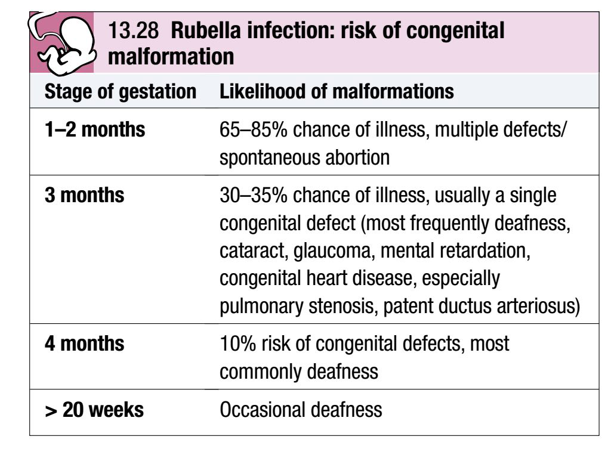

Slide 19
Diagnosis:
Laboratory confirmation of rubella is required if there has been contact with a pregnant woman.
This is achieved either by detection of rubella IgM in serum or by IgG seroconversion.
In the exposed pregnant woman, absence of rubella-specific IgG confirms the potential for congenital infection.

Slide 20
Prevention:
MMR should be administered as for measles.
Rubella is one of a number of infections that can occur during pregnancy with potentially serious consequences to mother or child.
All women of child-bearing age should also be tested for rubella and vaccinated if seronegative.

Slide 21
3- Parvovirus B19 (erythrovirus B19):
This virus causes a variety of clinical syndromes.
Approximately 50% of children and 60–90% of older adults are seropositive world-wide.
Most infections are spread by the respiratory route, although spread via contaminated blood is also possible.
The virus has particular tropism for red cell precursors.

Slide 22
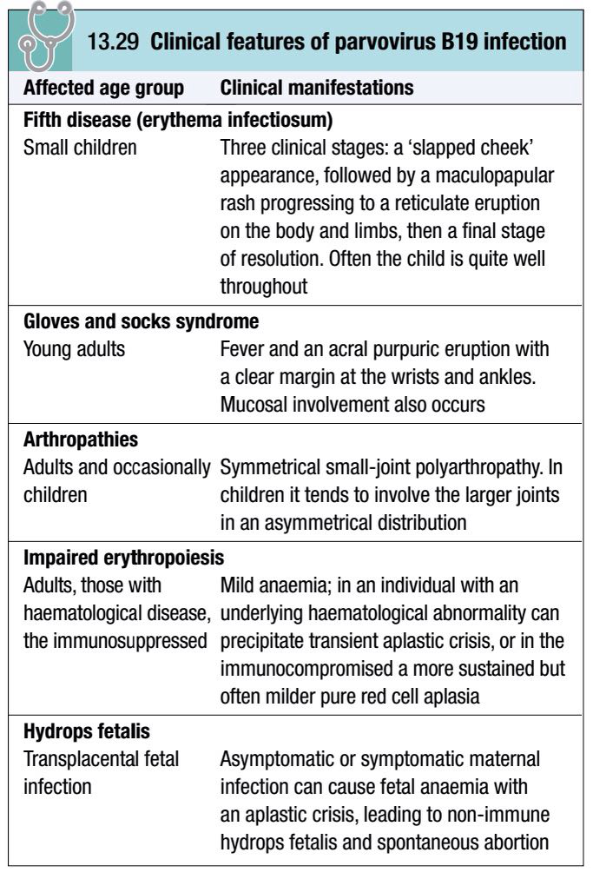

Slide 23
Clinical features:
Many infections are subclinical.
Clinical manifestations result after an incubation period of 14–21 days.
The classic exanthem (erythema infectiosum) is preceded by a prodromal fever and coryzal symptoms.

Slide 24
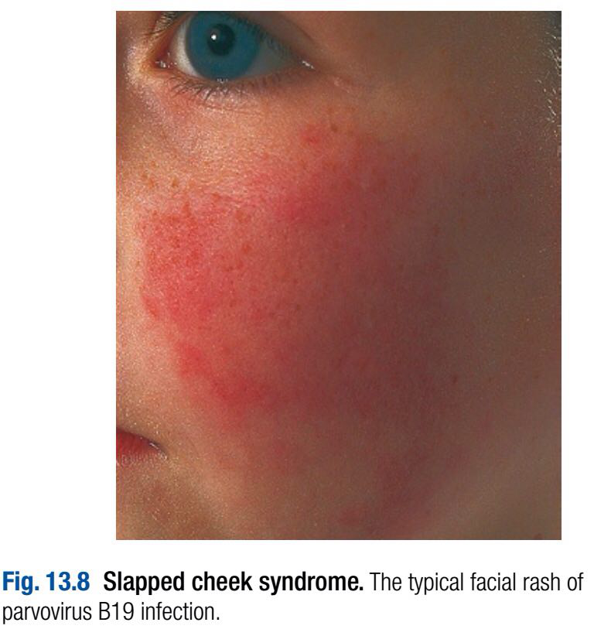
A ‘slapped cheek’ rash is characteristic but the rash is very variable.

Slide 25
In adults, polyarthropathy is common.
Infected individuals have a transient block in erythropoiesis for a few days, which is of no clinical consequence, except in individuals with increased red cell turnover due to haemoglobinopathy or haemolytic anaemia.
These individuals develop an acute anaemia which may be severe (transient aplastic crisis).

Slide 26
Erythropoiesis usually recovers spontaneously after 10–14 days.
Immunocompromised individuals, including those with congenital immunodeficiency or AIDS, can develop a more sustained block in erythropoiesis in response to the chronic viraemia that results from their inability to clear the infection.

Slide 27
Infection during the first two trimesters of pregnancy can result in intrauterine infection and impact on fetal bone marrow; it causes 10–15% of non-immune (non-Rhesus-related) hydrops fetalis, a rare complication of pregnancy.

Slide 28
Diagnosis:
IgM responses to parvovirus B19 suggest recent infection but may persist for months and false positives occur.
Seroconversion to IgG positivity confirms infection but in isolation a positive IgG is of little diagnostic utility.
Detection of parvovirus B19 DNA in blood is particularly useful in the immunocompromised host.
Giant pronormoblasts or haemophagocytosis may be demonstrable in the bone marrow.

Slide 29
Management:
Infection is usually self-limiting.
Symptomatic relief for arthritic symptoms may be required.
Severe anaemia requires transfusion.
Immunocompromised hosts should have immunosuppression decreased, if possible, and if viraemia persists should receive immunoglobulin to aid clearance.

Slide 30
Pregnant women should avoid contact with cases of parvovirus B19 infection; if they are exposed, serology should be performed to establish whether they are non-immune.

Slide 31
Passive prophylaxis with normal immunoglobulin has been suggested for non-immune pregnant women exposed to infection but there are limited data to support this recommendation.
The pregnancy should be closely monitored by ultrasound scanning, so that hydrops fetalis can be treated by fetal transfusion.

Slide 32
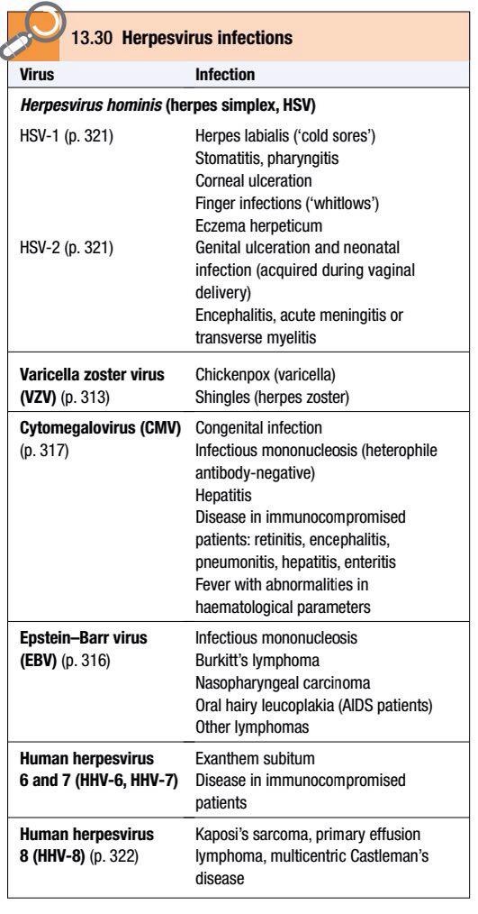
4- Human herpesvirus 6 and 7 (HHV-6 and HHV-7):
HHV-6 is a lymphotropic virus that causes a childhood viral exanthem (exanthem subitum), rare cases of an infectious mononucleosis-like syndrome and infection in the immunocompromised host.

Slide 33
Infection is almost universal, with approximately 95% of children acquiring this virus by 2 years of age.
Transmission is via saliva.

Slide 34
HHV-7 is very closely related to HHV-6, and is believed to be responsible for a proportion of cases of exanthem subitum.
Like HHV-6, HHV-7 causes an almost universal infection in childhood, with subsequent latent infection and occasional infection in the immunocompromised host.

Slide 35
Clinical features:
Exanthem subitum is also known as roseola infantum or sixth disease.
A high fever is followed by a maculopapular rash as the fever resolves.
Fever and/or febrile convulsions may also occur without a rash.
Rarely, older children or adults may develop an infectious mononucleosis-like illness, hepatitis or rash.
In the immunocompromised infection is rare but can cause fever, rash, hepatitis, cytopenia or encephalitis.

Slide 36
Diagnosis and management:
Exanthem subitum is usually a clinical diagnosis.
Laboratory diagnosis can be made by antibody and/or DNA detection, although these tests are not widely available.
The disease is self-limiting.
Treatment with ganciclovir has been used in immunocompromised hosts infected with HHV-6.

Slide 37
5- Chickenpox (varicella):
Varicella zoster virus (VZV) is a dermotropic and neurotropic virus that produces primary infection, usually in childhood, which may reactivate in later life.
VZV is spread by aerosol and direct contact.
It is highly infectious to non-immune individuals.
Disease in children is usually well tolerated.
Manifestations are more severe in adults, pregnant women and the immunocompromised.

Slide 38
Clinical features:
The incubation period is 11–20 days, after which a vesicular eruption begins, often on mucosal surfaces first, followed by rapid dissemination in a centripetal distribution (most dense on trunk and sparse on limbs).
New lesions occur every 2–4 days and each crop is associated with fever.

Slide 39
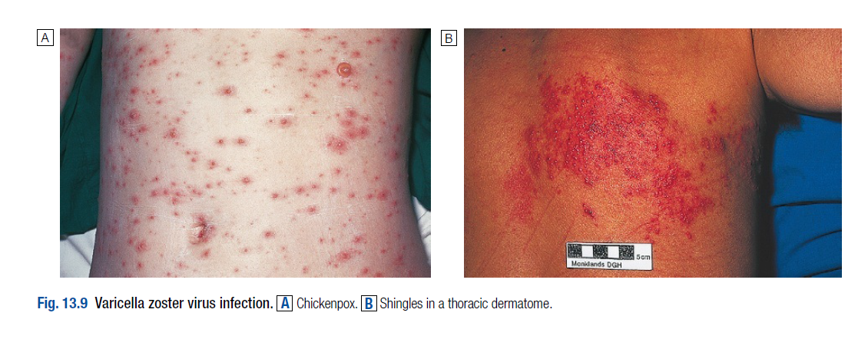

Slide 40
The rash progresses from small pink macules to vesicles and pustules within 24 hours.
Infectivity lasts from up to 4 days (but usually 48 hours) before the lesions appear until the last vesicles crust over.
Due to intense itching, secondary bacterial infection from scratching is the most common complication of primary chickenpox.
Self-limiting cerebellar ataxia and encephalitis are rare complications.

Slide 41
Adults, pregnant women and the immunocompromised are at increased risk of visceral involvement, which presents as pneumonitis, hepatitis or encephalitis.
Pneumonitis can be fatal and is more likely to occur in smokers.

Slide 42
Maternal infection in early pregnancy carries a 3% risk of neonatal damage with developmental abnormalities of eyes, CNS and limbs.
Chickenpox within 5 days of delivery leads to severe neonatal varicella with visceral involvement and haemorrhage.

Slide 43
Diagnosis:
Diagnosis is primarily clinical, by recognition of the rash.
If necessary, this can be confirmed by detection of antigen (direct immunofluorescence), DNA (PCR) or by viral culture of aspirated vesicular fluid.
Serology is used to identify seronegative individuals at risk of infection.

Slide 44
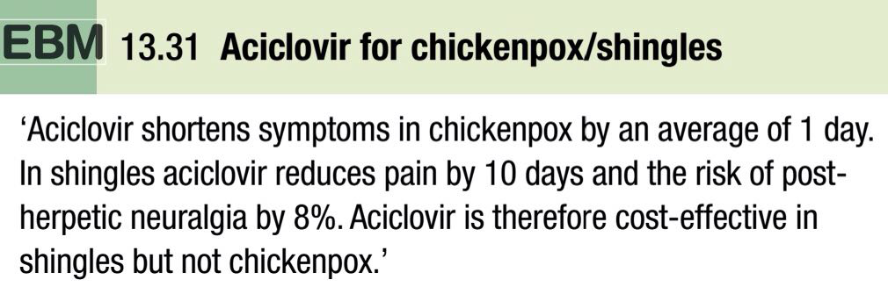
Management and prevention:
Antivirals, although effective if commenced within 48 hours of rash appearance, are not licensed in the UK for uncomplicated primary VZV infection, since published evidence suggests the benefits are marginal.

Slide 45
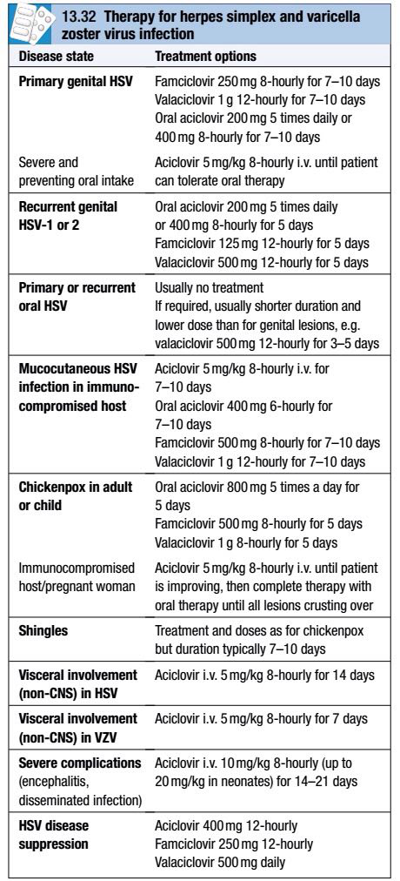
They are, however, widely used around the world for uncomplicated chickenpox in adults.
Treatment is required in individuals with complications and those who are immunocompromised, including pregnant women.

Slide 46
More severe disease, particularly in immunocompromised hosts, requires initial parenteral therapy.
Immunocompromised patients may have prolonged viral shedding and may require prolonged treatment until all lesions crust over.

Slide 47
Human VZ immunoglobulin (VZIG) is used to attenuate infection in people who have had significant contact with VZV, are susceptible to infection (i.e. have no history of chickenpox or shingles and are negative for serum VZV IgG) and are at risk of severe disease (e.g. immunocompromised, steroid-treated or pregnant).

Slide 48
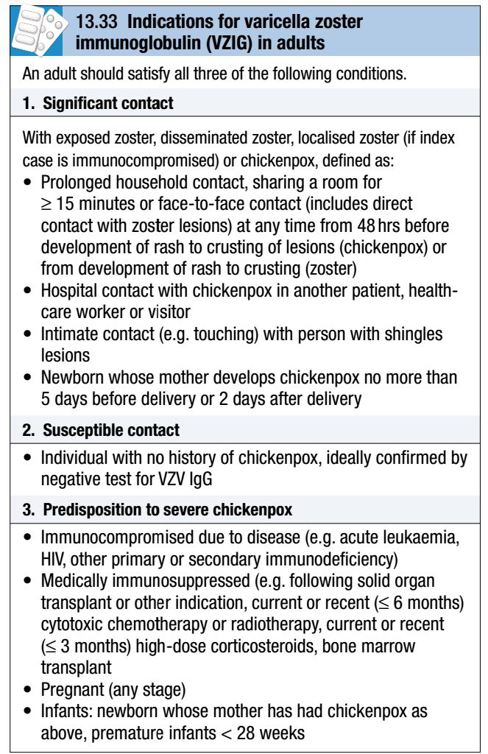

Slide 49
Ideally, VZIG should be given within 7 days of exposure, but it may attenuate disease even if given up to 10 days afterwards.
Susceptible contacts who develop severe chickenpox after receiving VZIG should be treated with aciclovir.

Slide 50
A live, attenuated VZV vaccine is available and in routine use in the USA and other countries.
Children receive one dose after 1 year of age and seronegative adults two doses.
The vaccine may also be used in patients prior to planned iatrogenic immunosuppression, e.g. before a transplant procedure.

Slide 51
Shingles (herpes zoster):
After initial infection VZV persists in latent form in the dorsal root ganglion of sensory nerves and can reactivate in later life as a localised rash or with other clinical manifestations.
Commonly seen in the elderly, shingles may also present in younger patients with immune deficiency.

Slide 52
Clinical features:
Burning discomfort occurs in the affected dermatome, where discrete vesicles appear 3–4 days later.
This is associated with a brief viraemia and can produce distant satellite ‘chickenpox’ lesions.
Severe disease, a prolonged duration of rash, multiple dermatomal involvement or recurrence suggests underlying immune deficiency, including HIV.

Slide 53
Chickenpox may be contracted from a case of shingles but not vice versa.
Although thoracic dermatomes are most commonly involved, the ophthalmic division of the trigeminal nerve is also frequently affected; vesicles may appear on the cornea and lead to ulceration.

Slide 54
This condition can lead to blindness and urgent ophthalmology review is required.
Geniculate ganglion involvement causes the Ramsay Hunt syndrome of facial palsy, ipsilateral loss of taste and buccal ulceration, plus a rash in the external auditory canal.
This may be mistaken for Bell’s palsy.
Bowel and bladder dysfunction occur with sacral nerve root involvement.

Slide 55
The virus occasionally causes myelitis or encephalitis.
Granulomatous cerebral angiitis is a cerebrovascular complication that leads to a stroke-like syndrome in association with shingles, especially in an ophthalmic distribution.
Post-herpetic neuralgia causes troublesome persistence of pain for 1–6 months or longer, following healing of the rash. It is more common with advanced age.

Slide 56
Management and prevention:
Early therapy with aciclovir or related agents has been shown to reduce both early- and late-onset pain, especially in patients over 65 years.
Post-herpetic neuralgia requires aggressive analgesia, along with agents such as amitriptyline 25–100 mg daily or gabapentin (commencing at 300 mg daily and building slowly to 300 mg 12-hourly or more).

Slide 57
Capsaicin cream (0.075%) may be helpful.
Studies are investigating the role of corticosteroids to reduce post-herpetic neuralgia.

Slide 58
6- Enteroviral exanthems:
Coxsackie or echovirus infections can lead to a maculopapular eruption or roseola-like rash that occurs after fever falls.

Slide 59
Systemic viral infections without exanthem:
Other systemic viral infections present with features other than a rash suggestive of exanthem.
Rashes may occur in these conditions but differ from those seen in exanthems or are not the primary presenting feature.

Slide 60
1- Mumps:
Mumps is a systemic viral infection characterised by swelling of the parotid glands.
Infection is endemic world-wide and peaks at 5–9 years of age.
Vaccination has reduced the incidence in children but incomplete coverage has increased susceptibility amongst older non-immune adults.
Infection is spread by respiratory droplets.

Slide 61
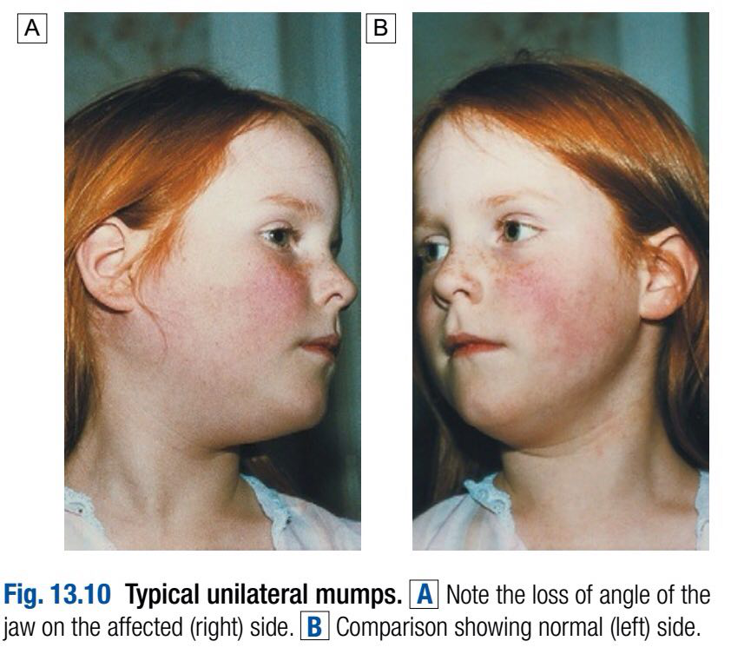
Clinical features:
The median incubation period is 19 days, with a range of 15–24 days.
Classical tender parotid enlargement, which is bilateral in 75%, follows a prodrome of pyrexia and headache.

Slide 62
In non-vaccinated communities, mumps is the most common cause of sporadic viral meningitis, and meningitis complicates up to 10% of cases.
The cerebrospinal fluid (CSF) reveals a lymphocytic pleocytosis, or less commonly neutrophils.

Slide 63
Rare complications include encephalitis, transient hearing loss, labyrinthitis, electrocardiographic abnormalities, pancreatitis and arthritis.

Slide 64
Approximately 25% of post-pubertal males with mumps develop epididymo-orchitis but, although testicular atrophy occurs, sterility is unlikely.
Oophoritis is much less common.
Abortion may occur if infection takes place in the first trimester of pregnancy.
Complications may occur in the absence of parotitis.

Slide 65
Diagnosis:
The diagnosis is usually clinical.
In atypical presentations without parotitis, serology for mumps-specific IgM or IgG seroconversion (four-fold rise in IgG convalescent titre) confirms the diagnosis.
Virus can also be cultured from urine in the first week of infection or detected by PCR in urine, saliva or CSF.

Slide 66
Management and prevention:
Treatment is with analgesia.
There is no evidence that corticosteroids are of value for orchitis.
Mumps vaccine is one of the components of the combined MMR vaccine.

Slide 67
2- Influenza:
Influenza is an acute systemic viral infection that primarily affects the respiratory tract; it carries a significant mortality.
It is caused by influenza A virus or, in milder form, influenza B virus.
Infection is seasonal, and variation in the haemagglutinin (H) and neuraminidase (N) glycoproteins on the surface of the virus leads to disease of variable intensity each year.

Slide 68
Minor changes in haemagglutinin are known as ‘genetic drift’, whereas a switch in the haemagglutinin or neuraminidase antigen is termed ‘genetic shift’.
Nomenclature of influenza strains is based on these glycoproteins, e.g. H1N1, H3N2 etc.

Slide 69
Genetic shift results in the circulation of a new influenza strain within a community to which few people are immune, potentially initiating an influenza epidemic or pandemic in which there is a high attack rate and there may be increased disease severity.

Slide 70
Clinical features:
After an incubation period of 1–3 days, uncomplicated disease leads to fever, malaise and cough.
Viral pneumonia may occur, although pulmonary complications are most often due to superinfection with Strep. pneumoniae, Staph. aureus or other bacteria.

Slide 71
Rare extrapulmonary manifestations include myositis, myocarditis, pericarditis and neurological complications (Reye’s syndrome in children, encephalitis or transverse myelitis).

Slide 72
Diagnosis:
Acute infection is diagnosed by viral culture, or by antigen or RNA detection (reverse transcription (RT)-PCR) in a nasopharyngeal sample.
The disease may also be diagnosed retrospectively on the basis of seroconversion.

Slide 73
Management and prevention:
Administration of the neuraminidase inhibitors, oral oseltamivir (75 mg 12-hourly) or inhaled zanamivir (10 mg 12-hourly) for 5 days can reduce the severity of symptoms if started within 48 hours of symptom onset (or possibly later in immunocompromised individuals).

Slide 74
These agents have superseded amantadine and rimantadine.
Antiviral drugs can also be used as prophylaxis in high-risk individuals during the ‘flu’ season.
Resistance can emerge to all of these agents.

Slide 75
The major mechanism of prevention is seasonal vaccination of the elderly and of individuals with chronic medical illnesses which place them at increased risk of the complications of influenza, such as chronic cardiopulmonary diseases or immune compromise.

Slide 76
Health-care workers should also receive annual vaccination.
The vaccine composition changes each year to reflect the predominant strains circulating but is of limited efficacy when a new pandemic strain emerges.

Slide 77
Avian influenza:
Avian influenza is caused by influenza A viruses with alternative haemagglutinin antigens, including the H5N1 strain.
These viruses have an increased ability to bind to lower respiratory tract epithelium, causing more severe disease with increased incidence of viral pneumonia and respiratory failure.

Slide 78
The majority of cases have occurred in individuals with a history of exposure to poultry, predominantly in South-east Asia.
However, in recent ‘flu’ seasons, cases have spread further west and infection has been identified in Europe in migrating birds and imported poultry.

Slide 79
Existing strains have been associated with infrequent person-to-person transmission but there is a concern that adaptation of an avian strain to allow effective person-to-person transmission is likely to lead to a global pandemic of life-threatening influenza.
Vaccination against seasonal ‘flu’ does not adequately protect against avian influenza.

Slide 80
Cases are diagnosed by recognising the relevant epidemiological factors and should be confirmed with specific tests.
Avian strains are susceptible to the neuraminidase inhibitors, although strains resistant to oseltamivir have been reported.

Slide 81
Swine influenza:
Occasional cases of influenza are transmitted from pigs to humans.
An outbreak of swine ‘flu’ began in 2009, initially in Mexico and then spreading around the world.
The causative strain was shown to be an H1N1 strain which showed significant genetic variation from human strains of H1N1.

Slide 82
Clinical features of infections with this strain are typical of influenza A infection, although some cases have more pronounced enteric features.
Mortality can occur, in particular in individuals with medical comorbidities.
Management of such an outbreak involves good infection control with an emphasis on hand hygiene and preventing dissemination of infection by coughing and sneezing.

Slide 83
Neuraminidase inhibitors (oseltamivir and zanamivir), but not amantadine or rimantadine, were active against the initial strains of swine flu isolated in 2009 and have been used for treatment and prophylaxis of key contacts.

Slide 84
3-Infectious mononucleosis (IM) and Epstein–Barr virus (EBV):
IM is an acute viral illness characterised by pharyngitis, cervical lymphadenopathy, fever and lymphocytosis.
A variety of medical complications may ensue.
It is most often caused by EBV infection, but a variety of other viral infections (CMV, HHV-6, HIV-1) and toxoplasmosis can produce a similar clinical syndrome.

Slide 85
EBV is a gamma herpesvirus.
In developing countries, subclinical infection in childhood is virtually universal.
In developed countries, primary infection may be delayed until adolescence or early adult life.
Under these circumstances about 50% of infections result in typical IM.

Slide 86
The virus is usually acquired from asymptomatic excreters via saliva, either by droplet infection or environmental contamination in childhood, or by kissing among adolescents and adults.
EBV is not highly contagious and isolation of cases is unnecessary.

Slide 87
Clinical features:
IM has a prolonged and undetermined incubation period, followed in some cases by a prodrome of fever, headache and malaise.
This is followed by severe pharyngitis, which may include tonsillar exudates, and non-tender anterior and posterior cervical lymphadenopathy.

Slide 88
Palatal petechiae, periorbital oedema, splenomegaly, inguinal or axillary lymphadenopathy, and macular, petechial or erythema multiforme rashes may occur.

Slide 89
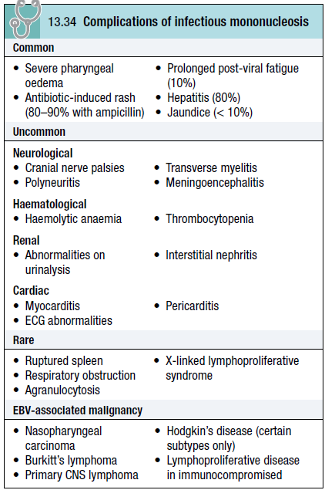
In most cases fever resolves over 2 weeks, and fatigue and other abnormalities settle over a further few weeks.

Slide 90
Death is rare but can occur due to respiratory obstruction, haemorrhage from splenic rupture or thrombocytopenia, or encephalitis.
The diagnosis of IM outside the usual age in adolescence and young adulthood is difficult.

Slide 91
In children under 10 years the illness is mild and short-lived, but in adults over 30 years of age it can be severe and prolonged.
In both groups pharyngeal symptoms are often absent.
IM may present with jaundice, as a PUO or with a complication.

Slide 92
Long-term complications of EBV infection:
Lymphoma complicates EBV infection in immunocompromised hosts, and some forms of Hodgkin’s disease are EBV-associated.
The endemic form of Burkitt’s lymphoma complicates EBV infection in areas of sub-Saharan Africa where falciparum malaria is endemic.

Slide 93
Nasopharyngeal carcinoma is a geographically restricted tumour seen in China and Alaska that is associated with EBV infection.
X-linked lymphoproliferative (Duncan’s) syndrome is a familial lymphoproliferative disorder that follows primary EBV infection in boys without any other history of immunodeficiency.

Slide 94
The course is frequently fatal due to liver failure, haemophagocytosis, lymphoma or progressive agammaglobulinaemia, complicated by infection.
The disorder is due to mutation of the SAP gene, involved in cell signalling in lymphocytes, and results in failure to contain EBV infection.

Slide 95
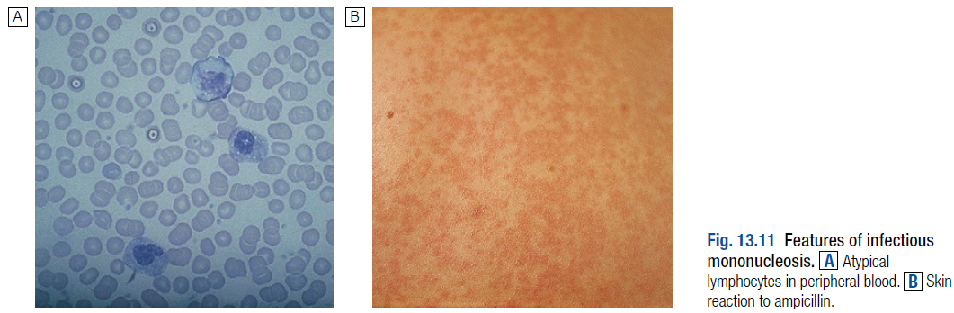
Investigations:
Atypical lymphocytes are common in EBV infection but also occur in other causes of IM, acute retroviral syndrome with HIV infection, viral hepatitis, mumps and rubella.

Slide 96
A ‘heterophile’ antibody is present during the acute illness and convalescence, which is detected by the Paul–Bunnell or ‘Monospot’ test.
Sometimes antibody production is delayed, so an initially negative test should be repeated.
However, many children and 10% of adolescents with IM do not produce heterophile antibody at any stage.

Slide 97
Specific EBV serology (immunofluorescence) can be used to confirm the diagnosis if necessary.
Acute infection is characterised by IgM antibodies against the viral capsid, antibodies to EBV early antigen and the initial absence of antibodies to EBV nuclear antigen (anti- EBNA).

Slide 98
Seroconversion of anti-EBNA at approximately 1 month after the initial illness may confirm the diagnosis in retrospect.
CNS infections may be diagnosed by detection of viral DNA in cerebrospinal fluid.

Slide 99
Management:
Treatment is largely symptomatic.
If a throat culture yields a β-haemolytic streptococcus, a course of penicillin should be prescribed.
Administration of ampicillin or amoxicillin in this condition commonly causes an itchy macular rash, and should be avoided.

Slide 100
When pharyngeal oedema is severe, a short course of corticosteroids, e.g. prednisolone 30 mg daily for 5 days, may help.
Antivirals are not sufficiently active against EBV.

Slide 101
Return to work or school is governed by the patient’s physical fitness rather than laboratory tests.
However, contact sports should be avoided until splenomegaly has completely resolved because of the danger of splenic rupture.
Unfortunately, about 10% of patients with IM suffer a chronic relapsing syndrome.

Slide 102
4- Cytomegalovirus (CMV):
CMV, like EBV, circulates readily among children.
A second period of virus acquisition occurs among teenagers and young adults, peaking between the ages of 25 and 35 years, rather later than with EBV infection.
CMV infection is persistent, and is characterized by subclinical cycles of active virus replication and by persistent low-level virus shedding.

Slide 103
Most post-childhood infections are therefore acquired from asymptomatic excreters who shed virus in saliva, urine, semen and genital secretions.
Sexual transmission and oral spread are common among adults, but infection may also be acquired by women caring for children with asymptomatic infections.

Slide 104
Clinical features:
Most post-childhood CMV infections are subclinical, although some young adults develop an IM-like syndrome and some have a prolonged influenza-like illness lasting 2 weeks or more.
Physical signs resemble those of IM, but in CMV mononucleosis hepatomegaly is relatively more common, while lymphadenopathy, splenomegaly, pharyngitis and tonsillitis are found less often.

Slide 105
Jaundice is uncommon and usually mild.
Unusual complications include meningoencephalitis, Guillain–Barré syndrome, autoimmune haemolytic anaemia, thrombocytopenia, myocarditis and skin eruptions such as ampicillin-induced rash.
Immunocompromised patients can develop hepatitis, oesophagitis, colitis, pneumonitis, retinitis, encephalitis and polyradiculitis.

Slide 106
Women who develop a primary CMV infection during pregnancy have about a 40% chance of passing CMV to the fetus, causing congenital infection and disease at any stage of gestation.
Features include petechial rashes, hepatosplenomegaly and jaundice; 10% of infected infants will have long-term CNS sequelae such as microcephaly, cerebral calcifications, chorioretinitis and deafness.

Slide 107
Infections in the newborn usually are asymptomatic or have features of an IM-like illness, although some studies suggest subtle sequelae affecting hearing or mental development may occur.

Slide 108
Investigations:
Atypical lymphocytosis is not as prominent as in IM and heterophile antibody tests are negative.
LFTs are often abnormal, with an alkaline phosphatase level raised out of proportion to transaminases.
Serological diagnosis depends on the detection of CMV-specific IgM antibody plus a four-fold rise or seroconversion of IgG.

Slide 109
In the immunocompromised, antibody detection is unreliable and detection of CMV in an involved organ by PCR, culture or histopathology establishes the diagnosis.
A positive culture of CMV in the blood may be useful in transplant populations but not in HIV-positive individuals, since in HIV infection CMV reactivates at regular intervals but these episodes do not correlate well with episodes of clinical disease.

Slide 110
Detection of CMV in urine is not helpful in diagnosing infection, except in neonates, since viruses are intermittently shed in the urine throughout life following infection.

Slide 111
Management:
Only symptomatic treatment is required in the immunocompetent patient.
Immunocompromised individuals are treated with ganciclovir 5 mg/kg i.v. 12-hourly or with oral valganciclovir 900 mg 12-hourly for at least 14 days.
Foscarnet or cidofovir is also used in CMV treatment of immunocompromised patients who are resistant or intolerant of ganciclovir-based therapy.

Slide 112
5- Dengue:
The dengue flavivirus is a common cause of fever and acute systemic illness in the tropics.
It is endemic in South-east Asia and India, and is also seen in Africa, the Caribbean and the Americas.

Slide 113
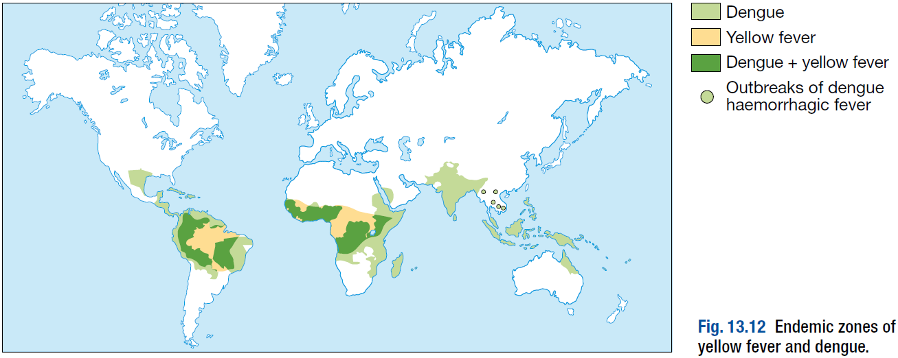

Slide 114
The principal vector is the mosquito Aedes aegypti, which breeds in standing water; collections of water in containers, water-based air coolers and tyre dumps are a good environment for the vector in large cities.
Aedes albopictus is a vector in some South-east Asian countries.

Slide 115
There are four serotypes of dengue virus, all producing a similar clinical syndrome; homotypic immunity after infection with one of the serotypes is life-long, but heterotypic immunity against the other serotypes lasts only a few months after infection.

Slide 116
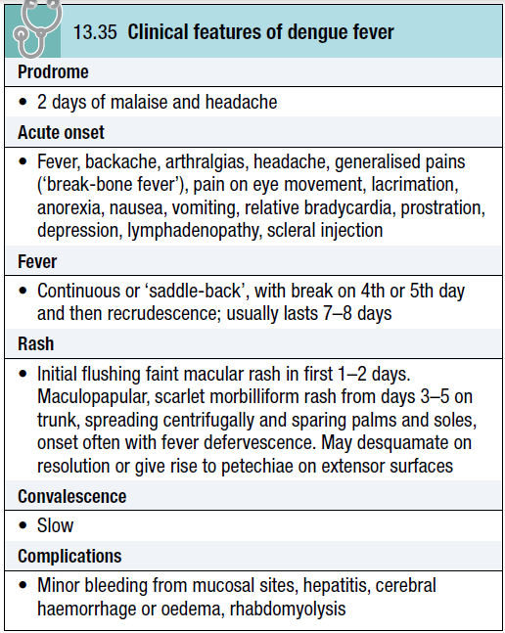
Clinical features:
The incubation period from being bitten by an infected mosquito is usually 2–7 days.
Asymptomatic infections are common but the disease is more severe in infants and the elderly.

Slide 117
A morbilliform rash, which characteristically blanches under pressure, may occur, often as the fever is settling.
A more severe illness, called dengue haemorrhagic fever or dengue shock syndrome, occurs mainly in children in South-east Asia.

Slide 118
In mild forms, there is thrombocytopenia and haemoconcentration.
In the most severe form, after 3–4 days of fever, hypotension and circulatory failure develop with pleural effusions, ascites, hypoalbuminaemia and features of acute respiratory distress syndrome (ARDS).

Slide 119
Minor (petechiae, ecchymoses, epistaxis) or major (gastrointestinal or cerebrovascular) haemorrhagic signs may occur.
The pathogenesis is unclear but pre-existing active or passive immunity to a dengue virus serotype different to the one causing the current infection is a predisposing factor; these heterotypic antibodies cause enhanced virus entry and replication in monocytes in vitro

Slide 120
Cytokine release is thought to be the cause of capillary leak causing effusions, and disseminated intravascular coagulation (DIC) may contribute to haemorrhage.
Adults rarely have classical dengue shock syndrome but they may have a stormy and fatal course characterised by elevated liver enzymes, haemostatic abnormalities and gastrointestinal bleeding.

Slide 121
Diagnosis:
Diagnosis of dengue is easier in an endemic area when a patient has the characteristic symptoms and signs.
However, mild cases may have a similar presentation to other viral infections.
Leucopenia is usual and thrombocytopenia common.

Slide 122
The diagnosis is confirmed by either a fourfold rise in IgG antibody titres, isolation of dengue virus from blood or detection of dengue virus RNA by PCR.
Serological tests may detect cross-reacting antibodies against other flaviviruses, including yellow fever vaccine.

Slide 123
Management and prevention:
Treatment is symptomatic.
Aspirin should be avoided due to bleeding risk.
Volume replacement and blood transfusions may be indicated in patients with shock.
With intensive care support, mortality rates are 1% or less.
Corticosteroids have not been shown to help.
No existing antivirals are effective.

Slide 124
Breeding places of Aedes mosquitoes should be abolished and the adults destroyed by insecticides.
There is no licensed vaccine available.

Slide 125
6- Yellow fever:
Yellow fever is a haemorrhagic fever of the tropics, caused by a flavivirus.
It is a zoonosis of monkeys in West and Central African, and South and Central American tropical rainforests, where it may cause devastating epidemics.
Transmission is by tree-top mosquitoes Aedes africanus (Africa) and Haemagogus spp. (America).

Slide 126
The infection is introduced to humans either by infected mosquitoes when trees are felled, or by monkeys raiding human settlements.
In towns, yellow fever may be transmitted between humans by Aedes aegypti, which breeds efficiently in small collections of water.

Slide 127
The distribution of this mosquito is far wider than that of yellow fever and more widespread infection is a continued threat.
Yellow fever causes between 200000 and 300000 deaths each year, mainly in sub-Saharan Africa, where it remains a major public health problem.

Slide 128
Overall mortality is around 15%, although this varies widely.
Humans are infectious during the viraemic phase, which starts 3–6 days after the bite of the infected mosquito and lasts for 4–5 days.

Slide 129
Clinical features:
After an incubation period of 3–6 days, yellow fever is often a mild febrile illness lasting less than 1 week with headache, myalgia, conjunctival erythema and bradycardia.
This is followed by fever resolution (defervescence), but in some cases fever recurs after a few hours to days.

Slide 130
In more severe disease, fever recrudescence is associated with lower back pain, abdominal pain and somnolence, prominent nausea and vomiting, bradycardia and jaundice.
Liver damage and DIC lead to bleeding with petechiae, mucosal haemorrhages and gastrointestinal bleeding.
Shock, hepatic failure, renal failure, seizures and coma may ensue.

Slide 131
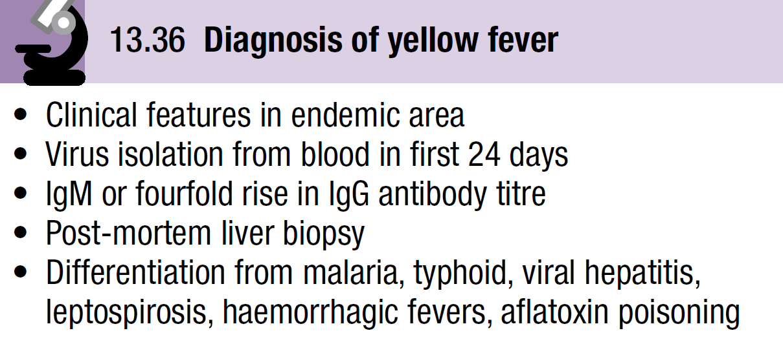
Diagnosis:

Slide 132
Leucopenia is characteristic. Liver biopsy should be avoided in life due to the risk of fatal bleeding.
Post-mortem features, such as acute mid-zonal necrosis and Councilman bodies with minimal inflammation in the liver, are suggestive but not specific.
Immunohistochemistry for viral antigens improves specificity.

Slide 133
Management and prevention:
Treatment is supportive, with meticulous attention to fluid and electrolyte balance, urine output and blood pressure.
Blood transfusions, plasma expanders and peritoneal dialysis may be necessary.
Patients should be isolated, as their blood and body products may contain virus particles.

Slide 134
A single vaccination with a live attenuated vaccine gives full protection for at least 10 years.
Potential side-effects include hypersensitivity, encephalitis and systemic features of yellow fever caused by the attenuated virus.
Vaccination is not recommended in people who are significantly immunosuppressed.

Slide 135
The risk of vaccine side-effects must be balanced against the risk of infection for less immunocompromised hosts, pregnant women and older patients.
An internationally recognised certificate of vaccination is sometimes necessary when crossing borders.

Slide 136
7- Viral haemorrhagic fevers (VHF):
VHF are zoonoses caused by several different viruses.
They are geographically restricted and occur in rural settings or in health-care facilities.
Serological surveys have shown that Lassa fever is widespread in West Africa and may lead to up to 500000 infections annually.
Mortality overall may be low, as 80% of cases are asymptomatic, but in hospitalised cases mortality averages 15%.

Slide 137
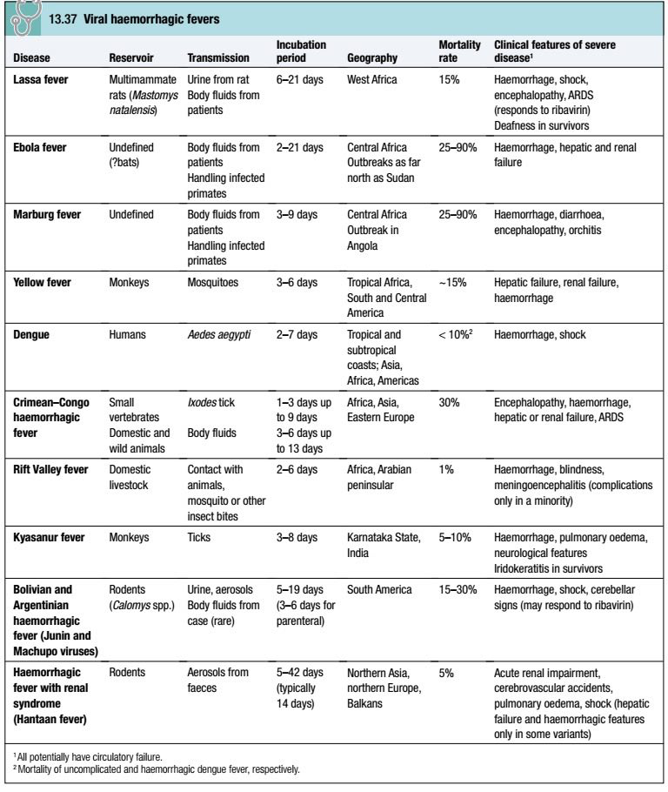

Slide 138
Ebola outbreaks have occurred at a rate of approximately 1 outbreak per year, involving up to a few hundred cases.
The largest outbreaks have been in the Democratic Republic of Congo, Uganda and Sudan.
Marburg has been documented less frequently, with outbreaks in the Democratic Republic of Congo and Uganda, but the largest outbreak to date involved 163 cases in Angola in 2005.
Mortality rates of Ebola and Marburg are high.

Slide 139
VHF have extended into Europe, with an outbreak of Congo–Crimean haemorrhagic fever in Turkey in 2006, and cases of haemorrhagic fever with renal syndrome in the Balkans and Russia.
These conditions remain very rare in the UK, with about 1 case of Lassa fever arriving in the country every 2 years.

Slide 140
Kyasanur forest disease is a tick-borne VHF currently confined to a small focus in Karnataka, India; there are about 500 cases annually.
Monkeys are the principal hosts, but with forest felling there are fears that this disease will increase.
All of these viral illnesses, except Ebola and Marburg, have mild self-limiting forms.

Slide 141
Clinical features:
All VHF have similar non-specific presentations with fever, malaise, body pains, sore throat and headache.
On examination conjunctivitis, throat injection, an erythematous or petechial rash, haemorrhage, lymphadenopathy and bradycardia may be noted.

Slide 142
The viruses cause endothelial dysfunction with the development of capillary leak.
Bleeding is due to endothelial damage and platelet dysfunction.
Hypovolaemic shock and ARDS may develop.
Haemorrhage is a late feature of VHF and most patients present with earlier features.
In Lassa fever, joint and abdominal pain are prominent.

Slide 143
A macular blanching rash may be present but bleeding is unusual, occurring in only 20% of hospitalised patients.
Encephalopathy may develop and deafness affects 30% of survivors.
The clue to the viral aetiology comes from the travel and exposure history.
Travel to an outbreak area, activity in a rural environment and contact with sick individuals or animals within 21 days all increase the risk of VHF.

Slide 144
Enquiry should be made about insect bites, hospital visits and attendance at ritual funerals (Ebola virus infection).
For Lassa fever retrosternal pain, pharyngitis and proteinuria have a positive predictive value of 80% in West Africa.

Slide 145
Investigations and management:
Non-specific findings include leucopenia, thrombocytopenia and proteinuria.
In Lassa fever an aspartate aminotransferase (AST) > 150 U/L is associated with a 50% mortality.

Slide 146
It is important to exclude other causes of fever, especially malaria, typhoid and respiratory tract infections.
Most patients suspected of having a VHF in the UK turn out to have malaria.

Slide 147
In patients with suspected VHF, strict infection control is important.
The diagnosis of VHF must be considered in all individuals who present with fever within 21 days of leaving an endemic area or who present with haemorrhage or organ failure.

Slide 148
A febrile patient from an endemic area within the incubation period, who has specific epidemiological risk factors or who has signs of organ failure or haemorrhage, should be treated as being at high risk of VHF.
These patients must be transferred to a centre with the appropriate biosafety facilities to care for them.

Slide 149
Individuals with a history of travel within 21 days and fever, but without the relevant epidemiological features or signs of VHF, are classified as medium-risk and should have an initial blood sample tested to exclude malaria.

Slide 150
If this is negative, relevant specimens (blood, throat swab, urine and pleural fluid (if available)) are collected and sent to an appropriate reference laboratory for nucleic acid detection (PCR), virus isolation, and serology.

Slide 151
If patients are felt to be at high risk of VHF or if infection is confirmed, they should be transferred to a specialised high-security infectious disease unit.
All further laboratory tests should be performed at biosafety level 4. Transport requires an ambulance with biosafety level 3 facilities.

Slide 152
In addition to general supportive measures, ribavirin is given intravenously (100 mg/kg, then 25 mg/kg daily for 3 days and 12.5 mg/kg daily for 4 days) when Lassa fever or South American haemorrhagic fevers are suspected.

Slide 153
Prevention:
Ribavirin has been used as prophylaxis in close contacts in Lassa fever but there are no formal trials of its efficacy.

Slide 154
Viral infections of the skin:
1- Herpes simplex virus 1 and 2 (HSV):
These cause widespread recurrent mucocutaneous infection; HSV-1 typically involves the mucocutaneous surfaces of the head and neck, whilst HSV-2 predominantly involves the genital mucosa, although there is overlap.

Slide 155
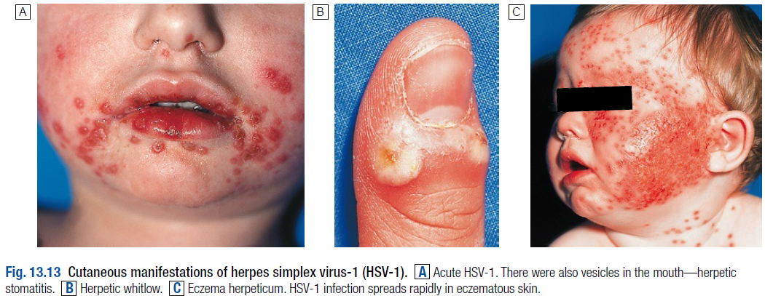

Slide 156
The seroprevalence of HSV-1 is 30–100%, varying by socioeconomic status, while that of HSV-2 is 20–60%.
Infection is acquired by inoculation of viruses shed by an infected individual on to a mucosal surface in a susceptible person.

Slide 157
The virus infects sensory and autonomic neurons and establishes latent infection in the nerve ganglia.
Primary infection is followed by episodes of reactivation throughout life.

Slide 158
Clinical features:
Primary HSV-1 or 2 infection is more likely to be symptomatic later in life, causing gingivostomatitis, pharyngitis or painful genital tract lesions.
The primary attack may be associated with fever and regional lymphadenopathy.

Slide 159
Recurrence:
Recurrent attacks occur throughout life, most often in association with concomitant medical illness, menstruation, mechanical trauma, immunosuppression, psychological stress or, for oral lesions, ultraviolet light exposure.
HSV reactivation in the oral mucosa produces the classical ‘cold sore’ or ‘herpes labialis’.

Slide 160
Prodromal hyperaesthesia is followed by rapid vesiculation, pustulation and crusting.
Recurrent HSV genital disease is a common cause of recurrent painful genital ulceration.

Slide 161
An inoculation lesion on the finger gives rise to a paronychia termed a ‘whitlow’ in contacts of patients with herpetic lesions.
It was formerly seen in health-care workers and dentists, but is prevented by protective gloves.

Slide 162
Complications:
Complications include disseminated cutaneous lesions in individuals with underlying dermatological diseases such as eczema (eczema herpeticum).
Herpes keratitis presents with pain and blurring of vision; characteristic dendritic ulcers are visible on slit-lamp examination and may produce corneal scarring and permanent visual impairment.

Slide 163
Primary HSV-2 can cause meningitis or transverse myelitis.
HSV is the leading cause of sporadic viral encephalitis; this serious complication may occur following either primary or secondary disease, usually with HSV-1.

Slide 164
A haemorrhagic necrotising temporal lobe cerebritis produces temporal lobe epilepsy and altered consciousness/coma.
Without treatment, mortality is 80%.
HSV is also implicated in the pathogenesis of Bell’s palsy with a lower motor neuron VII nerve palsy.

Slide 165
Neonatal HSV disease is usually associated with primary infection of the mother at term.
In excess of two-thirds of cases develop disseminated disease with cutaneous lesions, hepatitis, pneumonitis and frequently encephalitis.

Slide 166
Immunocompromised hosts can develop visceral disease with oesophagitis, hepatitis, pneumonitis, encephalitis or retinitis.

Slide 167
Diagnosis:
Differentiation from other vesicular eruptions is achieved by demonstration of virus in vesicular fluid by direct immunofluorescence or culture, or of virus DNA by PCR.
HSV encephalitis is diagnosed by detection of virus DNA in CSF.
Serology is of limited value, only confirming whether an individual has had previous infection.

Slide 168
Management:
The acyclic antivirals are the treatment of choice for HSV infection.
Therapy must commence in the first 48 hours of clinical disease (primary or recurrent); thereafter it is unlikely to influence clinical outcome.
Oral lesions in an immunocompetent individual may be treated with topical aciclovir.

Slide 169
All severe manifestations should be treated, regardless of the time of presentation.
Any reasonable suspicion of HSV encephalopathy is an indication for immediate empiric antiviral therapy.
Aciclovir resistance is encountered occasionally in immunocompromised hosts, in which case foscarnet is the treatment of choice.

Slide 170
2- Human herpesvirus 8 (HHV-8):
This virus causes Kaposi’s sarcoma in both AIDS-related and endemic non-AIDS-related forms.
HHV-8 is spread via saliva and men who have sex with men have increased incidence of infection.
Seroprevalence varies widely, being highest in sub-Saharan Africa.

Slide 171
HHV-8 also causes two rare haematological malignancies: primary effusion lymphoma and multicentric Castleman’s disease.
Current antivirals are not effective.

Slide 172
3- Enterovirus infections:
Hand, foot and mouth disease:
This systemic infection is usually caused by Coxsackie viruses or occasionally echoviruses.
It affects children and occasionally adults, resulting in local or household outbreaks, particularly in the summer months.

Slide 173
A relatively mild illness with fever and lymphadenopathy develops after an incubation period of approximately 10 days; 2–3 days later a painful papular or vesicular rash appears on palmoplantar surfaces of hands and
feet, with associated oral lesions on the buccal mucosa and tongue that ulcerate rapidly.

Slide 174
A papular erythematous rash may appear on buttocks and thighs.
Antiviral treatment is not available and management consists of symptom relief with analgesics.

Slide 175
Herpangina:
This infection, caused by Coxsackie viruses, primarily affects children and teenagers in the summer months.
It is characterised by a small number of vesicles at the soft/hard palate junction, often associated with high fever, an extremely sore throat and headache.

Slide 176
The lesions are short-lived, rupturing after 2–3 days and rarely persisting for more than 1 week.
Treatment is with analgesics if required.
Culture of the virus from vesicles or DNA detection by PCR differentiates herpangina from HSV.

Slide 177
4- Poxviruses:
These DNA viruses are rare but potentially important pathogens.

Slide 178
a. Smallpox (variola):
This severe disease, which has high mortality, was eradicated world-wide by a global vaccination programme.
Interest in the disease has re-emerged due to its potential as a bioweapon.
The virus is spread by the respiratory route or contact with lesions, and is highly infectious.

Slide 179
The incubation period is 7–17 days.
A prodrome with fever, headache and prostration leads in 1–2 days to the rash, which develops through macules and papules to vesicles and pustules, worst on the face and distal extremities.
Lesions in one area are all at the same stage of development with no cropping (unlike chickenpox).

Slide 180
Vaccination can lead to a modified course of disease with milder rash and lower mortality.
If a case of smallpox is suspected, national public health authorities must be contacted.

Slide 181
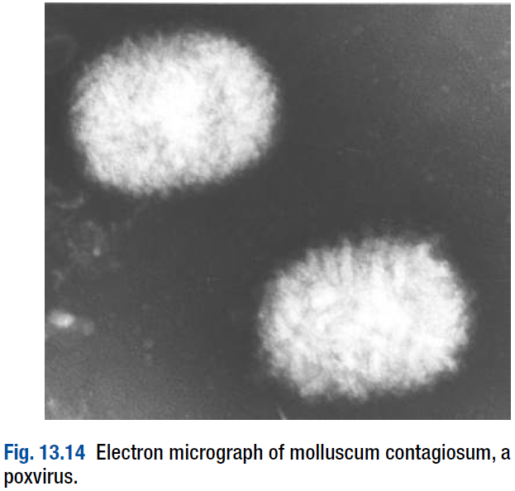
Electron micrography and DNA detection tests (PCR) are used to confirm smallpox or, using specific primers, an alternative poxvirus.

Slide 182
b. Monkeypox:
Despite the name, the animal reservoirs for this virus are probably small squirrels and rodents.
It causes a rare zoonotic infection in communities in the rainforest belt of central Africa, producing a vesicular rash indistinguishable from smallpox, but differentiated by the presence of lymphadenopathy.

Slide 183
Little person-to-person transmission occurs.
Recent outbreaks outside Africa have been linked to importation of African animals as exotic pets.
Diagnosis is by EM and/or DNA detection (PCR).

Slide 184
c. Cowpox:
Humans in contact with infected cows develop large vesicles, usually on the hands or arms and associated with fever and regional lymphadenitis.
The reservoir is thought to be wild rodents, and the virus also produces symptomatic disease in cats and a range of other animals.

Slide 185
d. Vaccinia virus:
This laboratory strain is the basis of the existing vaccine to prevent smallpox.
Widespread vaccination is no longer recommended due to the likelihood of local spread from the vaccination site (potentially life-threatening in those with eczema (eczema vaccinatum) or immune deficiency) and of encephalitis.
However, vaccination may still be recommended for key medical staff.

Slide 186
e. Orf:
Orf is an occupational hazard for those who work with sheep and goats, which transmit a parapoxvirus.
Inoculation of the virus, usually into the skin of a finger, causes significant inflammation and necrosis which usually resolve within 2–6 weeks.

Slide 187
No specific treatment is available, unless there is evidence of secondary infection.
Erythema multiforme can be provoked by orf infection.

Slide 188
f. Molluscum contagiosum:
Molluscum contagiosum is a common cutaneous infection with a poxvirus.
It can affect any age group but usually targets children over the age of 1 year.
The prevalence is also high in individuals who are immunosuppressed.

Slide 189
The classic lesion is a dome-shaped, ‘umbilicated’, skin-coloured papule with a central punctum.
The lesions tend to be multiple and are often found in sites of apposition such as the side of the chest and the inner arm; they resolve spontaneously but can take several months to do so.

Slide 190
Prior to resolution, they often become inflamed and may leave small, discrete, depressed scars.
A wide range of treatments has been tried but none is very effective and they can be painful; no treatment is an acceptable option.

Slide 191
Individual lesions can be removed by curettage under local anaesthetic but the lesions are commonly multiple.
Gentle squeezing with forceps after bathing can stimulate regression.

Slide 192
Topically applied chemicals such as salicylic acid (topical 5% acidified nitrite co-applied with 5% salicylic acid), podophyllin (topical 0.5% podophyllotoxin) and trichloroacetic acid cause marked inflammation and results vary.
Cryotherapy can be tried but is not as effective as gentle squeezing.

Slide 193
Physical occlusion with duct tape is advocated by some groups.
Topical 5% imiquimod cream has recently been shown to be effective

Slide 194
Gastrointestinal viral infections:
1- Norovirus (Norwalk agent):
Noroviruses have been associated with outbreaks of gastroenteritis in closed communities such as long-stay hospital wards, cruise ships and military camps.
Food handlers may also transmit this virus, which is relatively resistant to decontamination procedures.

Slide 195
Incubation periods are 24–48 hours.
High attack rates and prominent vomiting are characteristic.
Diagnosis is by electron microscopy, antigen or DNA detection (PCR) in stool samples.

Slide 196
2- Astrovirus:
Astroviruses cause diarrhoea in small children and occasionally in immunocompromised adults.

Slide 197
3- Rotavirus:
Rotaviruses are the major cause of diarrhoeal illness in young children world-wide and cause 10–20% of deaths due to gastroenteritis in developing countries.
There are winter epidemics in developed countries, particularly in nurseries.

Slide 198
Adults are less often infected but those in close contact with cases may develop disease.
The virus infects enterocytes, causing decreased surface absorption.
The incubation period is 48 hours and patients present with watery diarrhoea, vomiting, fever and abdominal pain. Dehydration is prominent.

Slide 199
Diagnosis is aided by commercially available enzyme immunoassay kits, which require fresh or refrigerated stool samples.
Immunity develops to natural infection.
A licensed vaccine is effective but is associated with increased rates of intussusception and so its use is not recommended.
Other vaccines are in development.

Slide 200
Other viruses:
Adenoviruses are frequently identified from stool culture and implicated as a cause of diarrhoea in children.
They have also been linked to cases of intussusception.

Slide 201
Respiratory viral infections:
Adenoviruses, rhinoviruses and enteroviruses (Coxsackie viruses and echoviruses) often produce non-specific symptoms.
Parainfluenza and respiratory syncytial viruses cause upper respiratory tract disease, croup and bronchiolitis in small children and pneumonia in the immunocompromised.

Slide 202
Respiratory syncytial virus also causes pneumonia in nursing home residents and may be associated with nosocomial pneumonia.
Metapneumovirus and bocavirus have emerged as new causes of upper respiratory tract infection and occasionally lower respiratory tract infection.

Slide 203
They may also cause pneumonia in immunosuppressed individuals, such as recipients of allogeneic bone marrow transplants.
The severe acute respiratory syndrome (SARS) caused by the SARS coronavirus emerged as a major respiratory pathogen during an outbreak in 2002–3, with 8000 cases and 10% mortality.

Slide 204
Viral infections with neurological involvement:
Japanese B encephalitis:
This flavivirus is an important cause of endemic encephalitis in Japan, China, Russia, South-east Asia, India and Pakistan; outbreaks also occur elsewhere.
There are 10000–20000 cases reported to the WHO annually.

Slide 205
Pigs and aquatic birds are the virus reservoirs and transmission is by mosquitoes.
Exposure to rice paddies is a recognised risk factor.

Slide 206
Clinical features:
The incubation period is 4–21 days.
Most infections are probably subclinical in childhood and only around 1% of infections lead to encephalitis.
There is an initial systemic illness with fever, malaise and anorexia, followed by photophobia, vomiting, headache and changes in brain-stem function.

Slide 207
Neurological features other than encephalitis include meningitis, seizures, cranial nerve palsies, flaccid or spastic paralysis, and extrapyramidal features.
Mortality with neurological disease is 25%.
Most children die from respiratory failure with infection of brain-stem nuclei.
Approximately 50% of survivors are left with neurological sequelae.

Slide 208
Investigations, management and :prevention
Other infectious causes of encephalitis should be excluded.
There is neutrophilia and often hyponatraemia.
CSF analysis reveals lymphocytosis and elevated protein.
Serological testing may be helpful and there is a CSF antigen test.

Slide 209
Treatment is supportive, anticipating and treating complications.
Vaccination for travellers to endemic areas during the monsoon period is effective prophylaxis.
Some endemic countries include this vaccination in their childhood schedules.

Slide 210
West Nile virus:
This flavivirus has emerged as an important cause of neurological disease in an area that extends from Australia, India and Russia through Africa and Southern Europe and across to North America.
The disease has an avian reservoir and a mosquito vector.
The elderly are at increased risk of neurological disease.

Slide 211
Clinical features:
Most infections are asymptomatic.
After 2–6 days’ incubation, a mild febrile illness and arthralgia constitute the most common clinical presentation.
A prolonged incubation may be seen in immunocompromised individuals.

Slide 212
Children may develop a maculopapular rash.
Neurological disease is seen in 1% and is characterised by encephalitis, meningitis or asymmetric flaccid paralysis with 10% mortality.

Slide 213
Diagnosis and management:
Diagnosis is by serology or detection of viral RNA in blood or CSF.
Serological tests may show cross-reactivity with other flaviviruses, including vaccine strains.
Treatment is supportive.

Slide 214
Enterovirus 71:
Enterovirus 71 has caused outbreaks around the globe of enteroviral disease with hand, foot and mouth disease and aseptic meningitis.
Some cases have been complicated by encephalitis with flaccid paralysis or by brain-stem involvement and death.
The virus can be isolated from vesicle fluid, stool or CSF, and viral RNA can be detected in CSF by RT-PCR.

Slide 215
Nipah virus encephalitis:
In 1999 a newly discovered paramyxovirus in the Hendra group, the Nipah virus, caused an epidemic of encephalitis amongst Malaysian pig farmers.
Infection is through direct contact with pig secretions.
Mortality is around 30%.
Antibodies to the Hendra virus are present in 76% of cases.

Slide 216
Human T cell lymphotropic virus type I (HTLV-1):
HTLV-I is a retrovirus which causes chronic infection with development of adult T-cell leukaemia/lymphoma or HTLV-1-associated myelopathy (HAM) in a subset of those infected.
It is found mainly in Japan, the Caribbean, Central and South America, and the Seychelles.

Slide 217
HAM or tropical spastic paraparesis occurs in < 5% of those with chronic infection, and presents with gait disturbance, spasticity of the lower extremities, urinary incontinence, impotence and sensory disturbance.
Myositis and uveitis may also occur with HTLV-1 infection.
Serology confirms the diagnosis.
Treatment is supportive.

Slide 218
Viral infections with rheumatological
:involvement
Rheumatological syndromes characterise a variety of viral infections ranging from exanthems, such as rubella and parvovirus B19, to blood-borne viruses, such as HBV and HIV-1.

Slide 219
Chikungunya virus:
Chikungunya is an alphavirus that causes fever, rash and arthropathy.
It is found principally in Africa and Asia, including India.
Humans and non-human primates are the main reservoir and the main vector is the Aedes aegypti mosquito.

Slide 220
Cases occur in epidemics on a background of sporadic cases.
In 2007 an outbreak extended as far north as Italy.
The incubation period is 2–12 days.
A period of fever may be followed by an afebrile phase and then recrudescence of fever.

Slide 221
Children may develop a maculopapular rash.
Adults are susceptible to arthritis, which causes early morning pain and swelling, most often in the small joints.
Arthritis can persist for months and may become chronic in HLA-B27-positive individuals.

Slide 222
Related alphaviruses causing similar syndromes include Sindbis virus (Scandinavia and Africa), O’nyong-nyong virus (Central Africa), Ross River virus (Australia) and Mayaro virus (Caribbean and South America).
Diagnosis is by serology but cross-reactivity between alphaviruses occurs.
Treatment is symptomatic.

Slide 223
PRION DISEASES
Prions cause spongiform encephalopathies in humans, sheep, cows and cats.

Slide 224
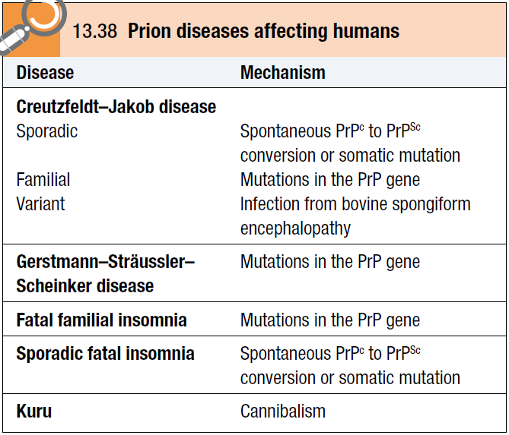

Slide 225
The prion protein is not inactivated by cooking or conventional sterilisation, and transmission is thought to occur by consumption of infected CNS tissue or by inoculation (e.g. via depth EEG electrodes, corneal grafts, cadaveric dura mater grafts and pooled cadaveric growth hormone preparations).
The same diseases can occur in an inherited form, due to mutations in the PrP gene.

Slide 226
The apparent transmission of bovine spongiform encephalopathy (BSE) to humans following an outbreak of BSE in the UK beginning in the late 1980s has caused great concern, leading to precautionary measures in the UK, such as leucodepletion of all blood used for transfusion, and the mandatory use of disposable surgical instruments wherever possible for tonsillectomy, appendicectomy and ophthalmological procedures.

Slide 227
THE END

